Slide 1

实验四：接口实验
卢光明

Slide 2
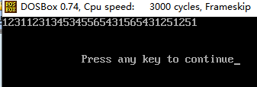
设计一个乐曲程序，通过计算机发出音响并奏出《两只老虎》的乐曲。程序中已经设置了乐谱。
提示：发声代码可以参考课本P285例题8.1，或第11讲ppt P33(更详细的理论基础可以参考课本P387）
结果如图：屏幕显示音符的数字表示，同时扬声器发出对应音符声音
感兴趣的同学可以自己设置数据，演奏其他的乐谱
DATAS segment
mus_freq dw 262,294,330,262,262,294,330,262 ;mus_freq数组存放的是乐谱,每一个数表示一个音符
dw 330,349,392,330,349,392,392,440
dw 392,349,330,262,392,440,392,349
dw 330,262,294,196,262,294,196,262
mus_time dw 2500,2500,2500,2500,2500,2500,2500,2500,2500,2500 ;mus_freq中对应音符持续时间
dw 5000,2500,2500,5000,1200,1200,1200,1200,2500,2500
dw 1200,1200,1200,1200,2500,2500,2500,2500,5000,2500,2500,5000
mes db 31h,32h,33h,31h,31h,32h,33h,31h,33h,34h,35h,33h,34h,35h,35h,36h ;乐谱的数字表示
db 35h,34h,33h,31h,35h,36h,35h,34h,33h,31h,32h,35h,31h,32h,35h,31h,'$'
DATAS ends

